Slide 1
Computer Networks & IOT (18B11CS311)
Even Semester_2023

Slide 2
Transport Layer

Slide 3
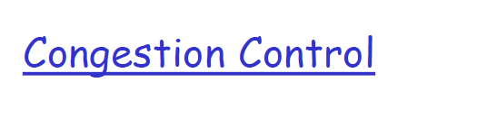
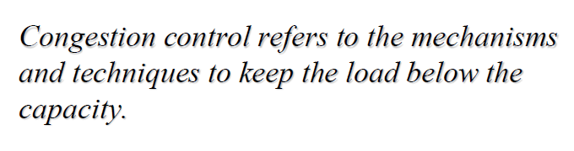

Slide 4
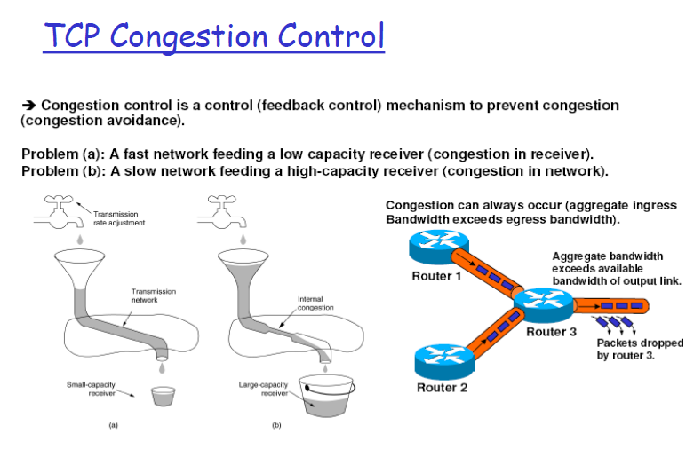

Slide 5
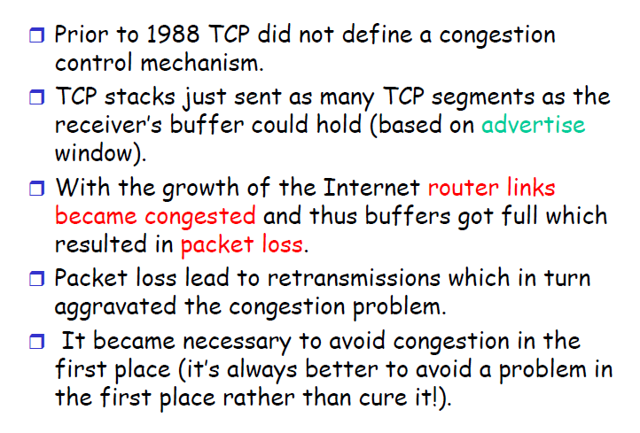

Slide 6
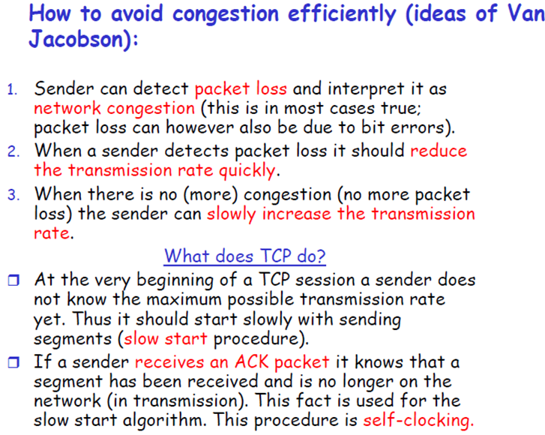

Slide 7
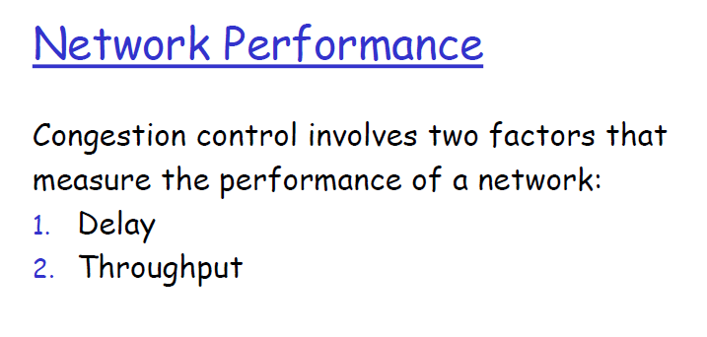
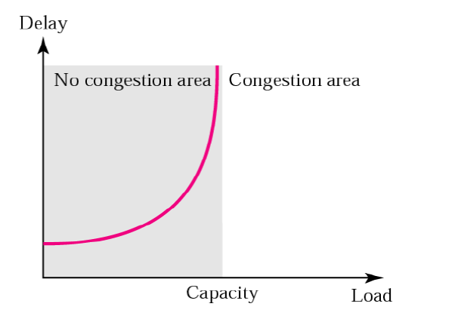
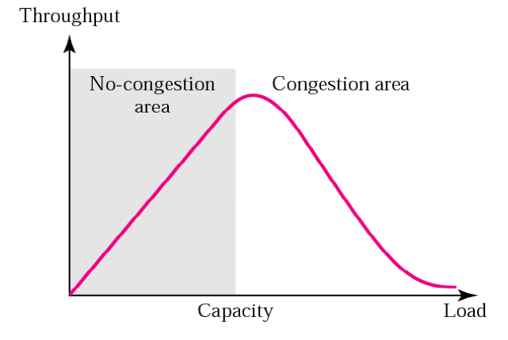

Slide 8
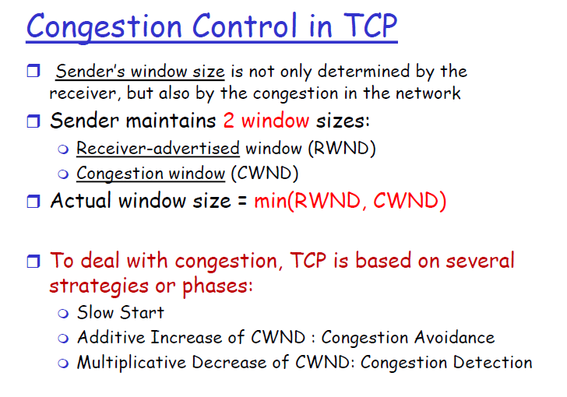

Slide 9
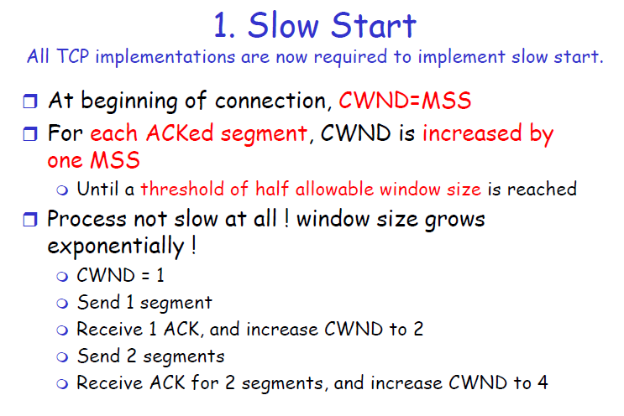

Slide 10
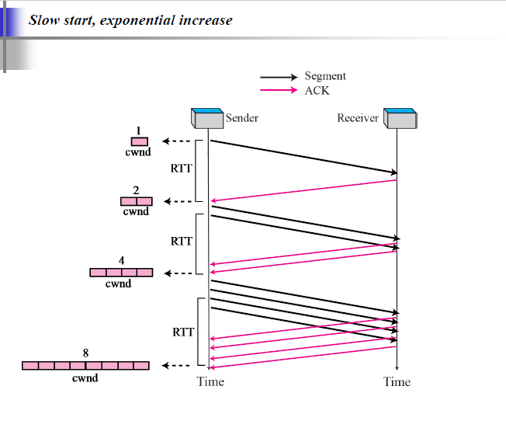

Slide 11
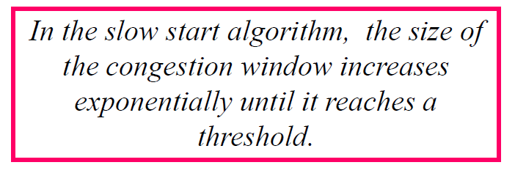

Slide 12
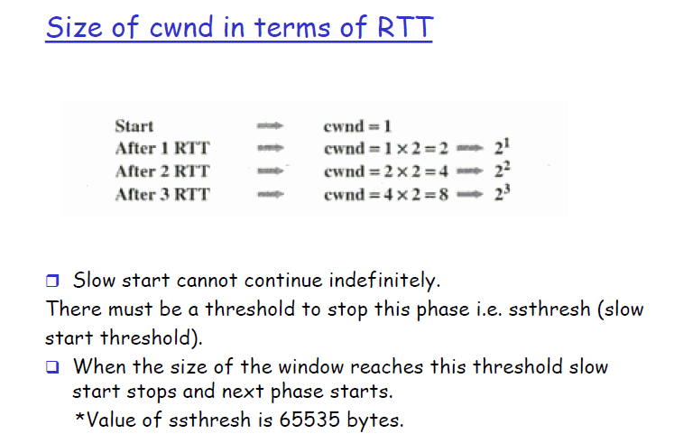

Slide 13
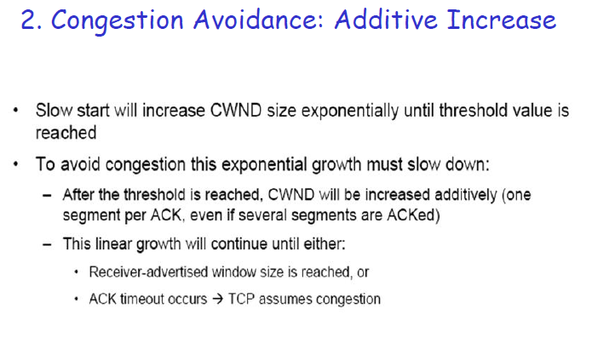

Slide 14
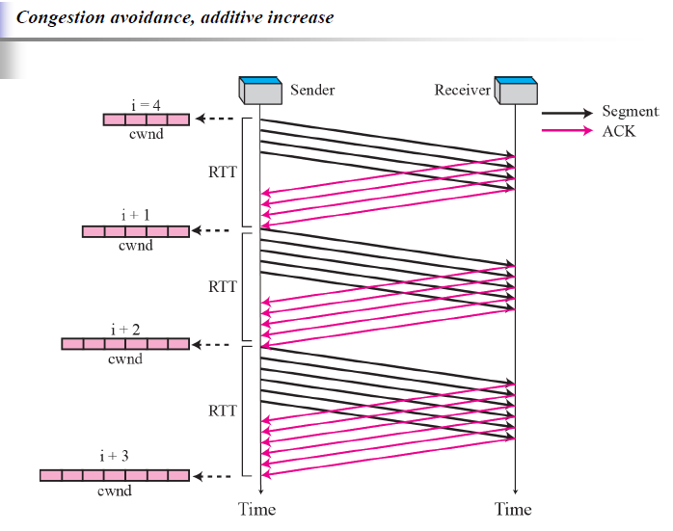

Slide 15
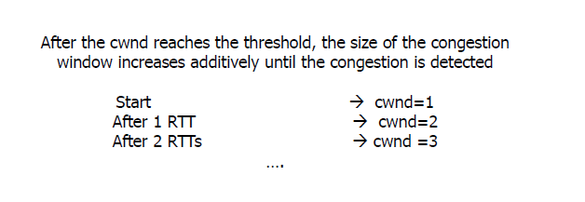

Slide 16
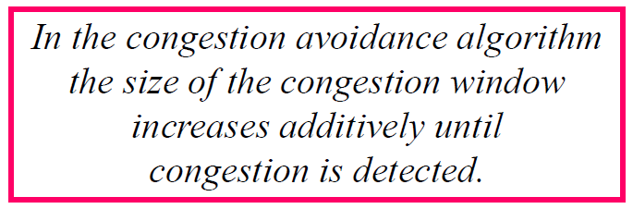

Slide 17
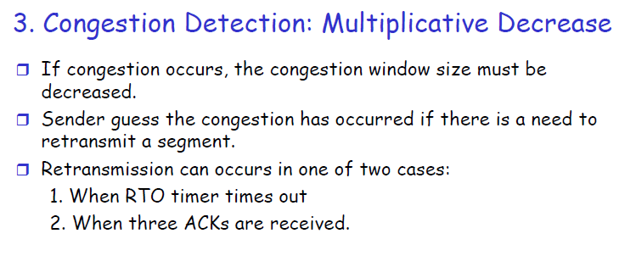

Slide 18
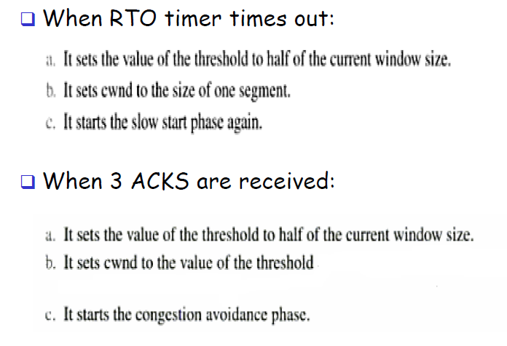

Slide 19
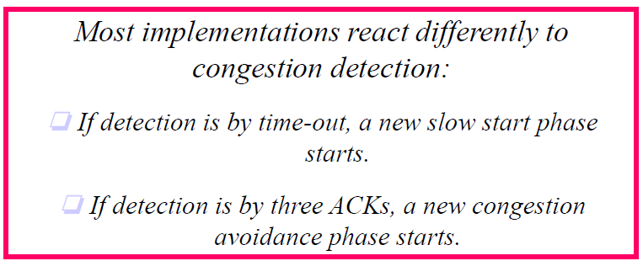

Slide 20
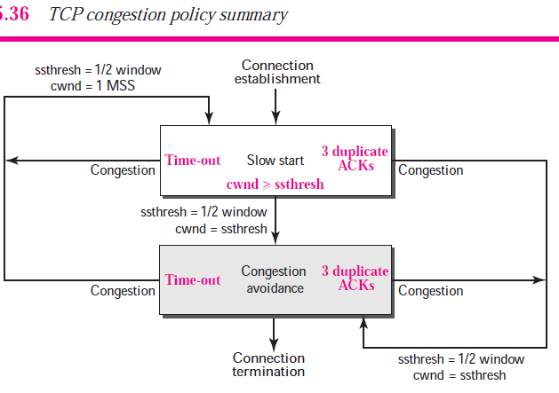

Slide 21
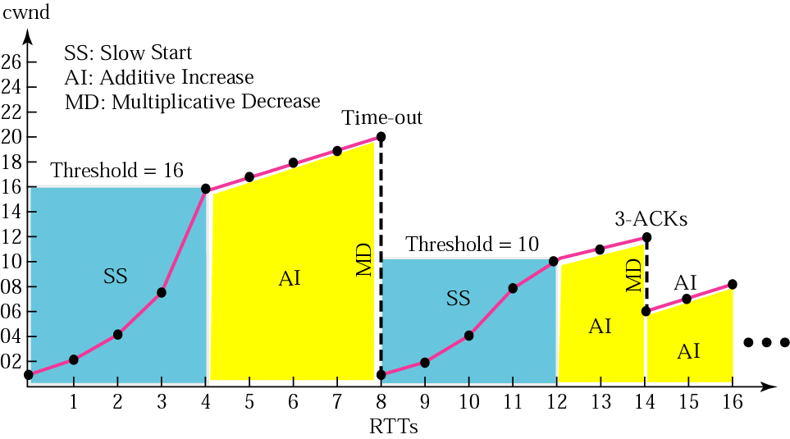
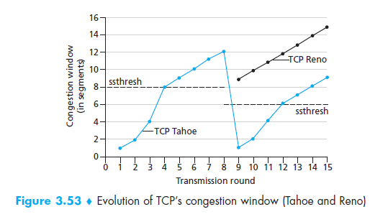
Figure 12.36 Congestion example

Slide 22
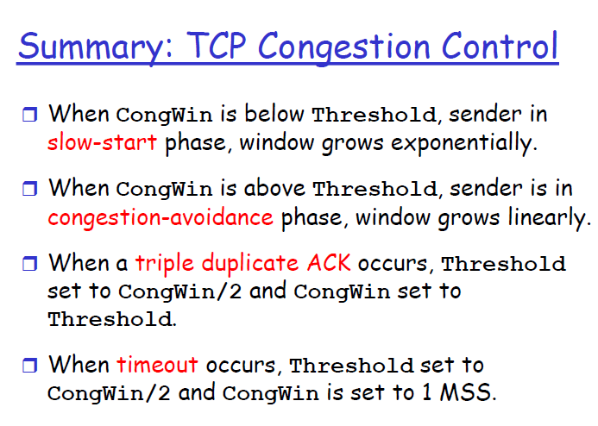

Slide 23
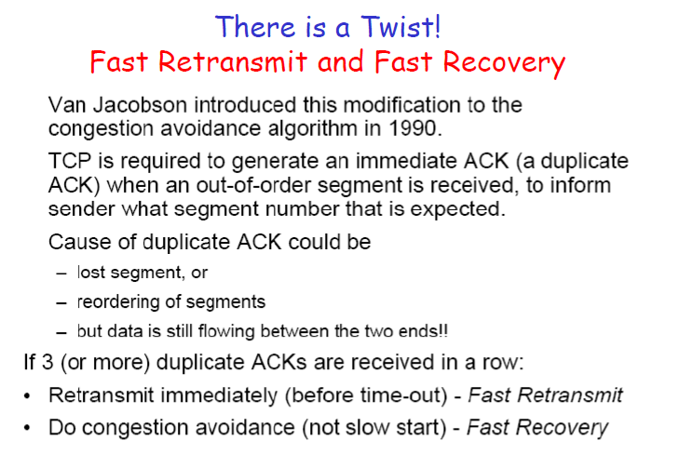

Slide 24
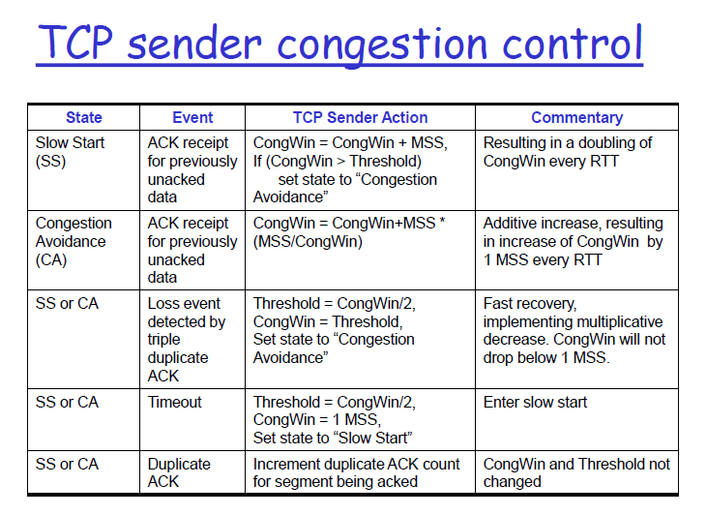

Slide 25
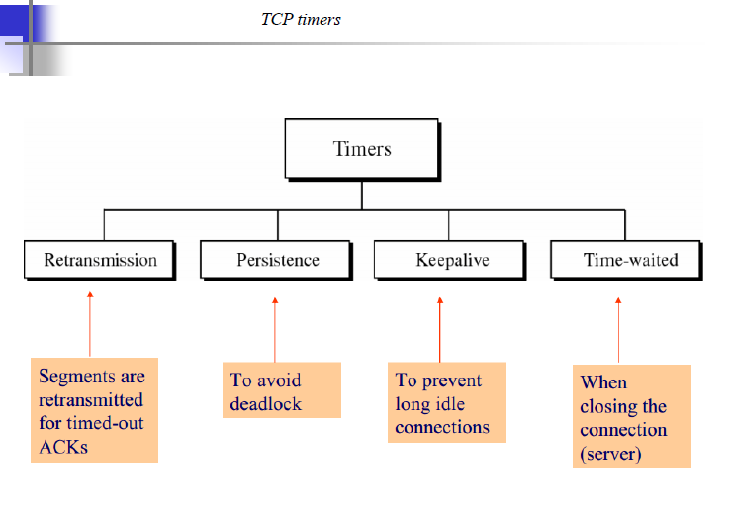

Slide 26
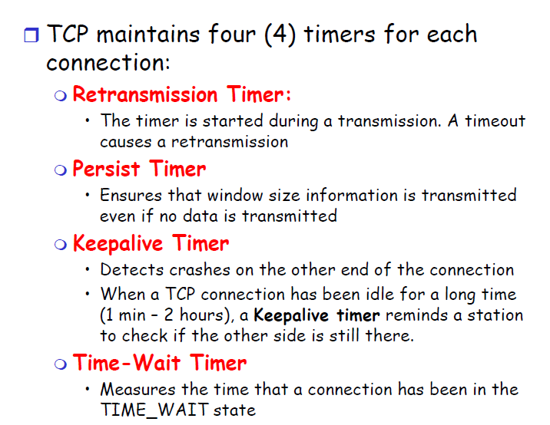

Slide 27
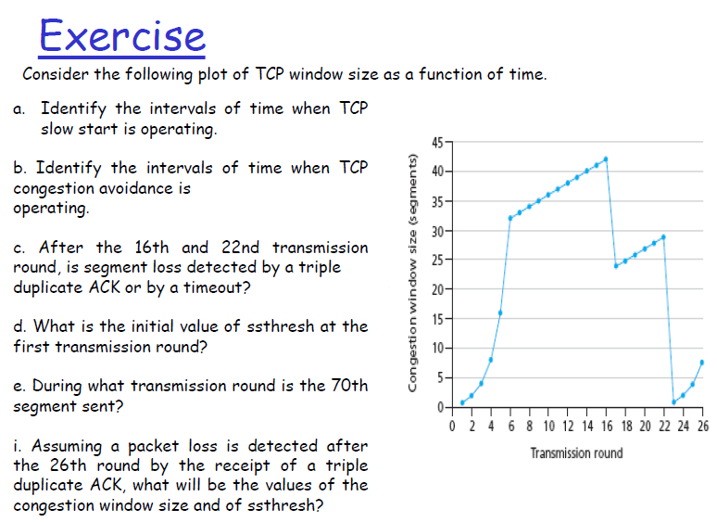

Slide 28
Solution:
a. Identify the intervals of time when TCP slow start is operating.
The slow start times are from 1 to 6 and from 23 to 26. These are slow start times because the congestion window size is picking up at a slope, slower at first and becoming exponentially faster until it gets to a linear section and is no longer in slow start.
b. Identify the intervals of time when TCP congestion avoidance is operating.
This is between transmission rounds 6 and 16 and between rounds 17 and 23. This is when it is linearly rising.
c. After the 16th and 22nd transmission round, is segment loss detected by a triple duplicate ACK or by a timeout?
If it had been a timeout, the congestion window would have dropped to 0 and had a slow start, but neither of those are true so it was detected by a triple ACK after 16th transmission round .
After the 22nd transmission round detected by a timeout for the reasons listed above.

Slide 29
d. What is the initial value of ssthresh at the first transmission round?
The initial value of ssthresh is 33 segments because that is the congestion window size in segments when it starts it’s linear rise which indicates congestion avoidance at transmission round 6. It remains at 33 segments until congestion avoidance ends.
e. During what transmission round is the 70th segment sent?
I find this out by adding up the segments that were sent in each transmission round. The congestion window is the segments. So in round 1, 1 segment is sent. Round 2, 2 segments. Round 3, segments 4-7. Round 4, segments 8-15. Round 5, segments 16-31. Round 6, segments 32-63. Round 7, segments 64-99. Therefore, the 70th segment is sent during the 7th transmission round.
f. Assuming a packet loss is detected after the 26th round by the receipt of a triple duplicate ACK, what will be the values of the congestion window size and of ssthresh?
The congestion window size would be 4 segments, and ssthresh would be 4.

Slide 30
TCP Tahoe and Reno
While both consider retransmission timeout (RTO) and duplicate ACKs as packet loss events, the behaviour of Tahoe and Reno differ primarily in how they react to duplicate ACKs:
Tahoe: if three duplicate ACKs are received (i.e. four ACKs acknowledging the same packet, which are not piggybacked on data and do not change the receiver's advertised window), Tahoe performs a fast retransmit, sets the slow start threshold to half of the current congestion window, reduces the congestion window to 1 MSS, and resets to slow start state.
Reno: if three duplicate ACKs are received, Reno will perform a fast retransmit and skip the slow start phase by instead halving the congestion window (instead of setting it to 1 MSS like Tahoe), setting the slow start threshold equal to the new congestion window, and enter a phase called fast recovery.
In both Tahoe and Reno, if an ACK times out (RTO timeout), slow start is used, and both algorithms reduce congestion window to 1 MSS.

Slide 31
TCP Tahoe = Slow Start + AIMD + Fast Retransmit
Slow Start phase: It lasts until congestion window size reaches up to “Slow Start Threshold (ssthresh)“. The slow start algorithm doubles the congestion window size(cwnd) in one RTT. Initially, ssthresh is set to infinite(∞). Subsequently, it adapts depending on the packet loss events. When cwnd becomes equal to ssthresh, slow start stops. After that AIMD phase takeovers.
AIMD phase: It starts when the slow start stops. Additive Increase increases cwnd by 1 and Multiplicative Decrease reduces ssthresh to 50% of cwnd. Note that cwnd is ‘not’ reduced by 50% but ssthresh. This is the point to note that cwnd again resets to the initial window size.
Fast Retransmit phase: It is the loss detection algorithm. It is triggered by 3 duplicate acknowledgments. On packet loss detection, it resets cwnd to initcwnd.

Slide 32
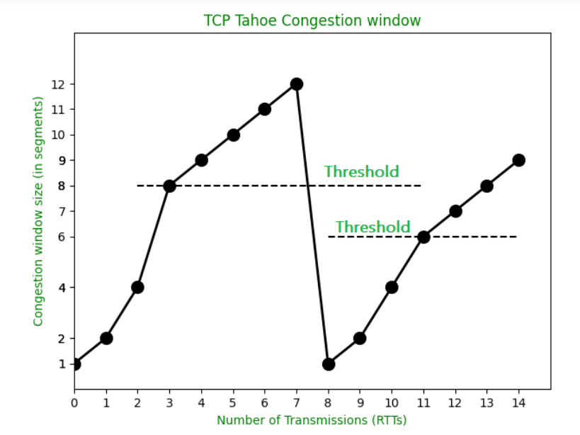

Slide 33
TCP Reno = TCP Tahoe + Fast Recovery
Since TCP Reno is the extension of TCP Tahoe, the slow start and AIMD phase are the same.
Fast Recovery phase
It makes use of both RTO and Fast Retransmit. If the packet loss detection is triggered by 3 duplicate acknowledgments then it is a fast retransmit algorithm in action. On packet loss detection through Fast Retransmit, cwnd is reduced by 50% (cwnd = cwnd/2). 3 duplicate ACKs are received that means network is performing well because ACKs are being received which means packets are getting delivered to the receiver. So, cwnd is reduced by 50% in order to allow the network to come out of congested state. On packet loss detection through RTO, reset cwnd to initcwnd. If the RTO timer expires that means the network is badly congested. So, the cwnd has to be reduced to the initial value in order to recover the network from congestion.

Slide 34
